Slide 1
Java Decision Control Structures
ICS2 – Introduction to Programming

Slide 2
Decision Control Structures
Statements that is organized in such a way that there should be a condition to be evaluated first
The behavior of the program will depend on the truthfulness of a condition being tested
The result of the condition will dictate the course of action to be taken

Slide 3
Conditional Operator (?:)
The ?: is a ternary operator since it takes three arguments that together form a conditional expression
Syntax:
expr1 ? expr2 : expr3
Idea behind ?: is that if expr1 is true, value of expr2 is returned, otherwise, expr3 is returned

Slide 4
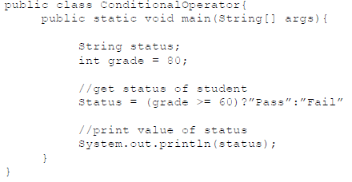

Slide 5
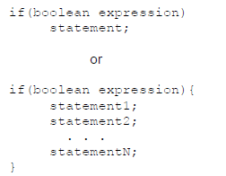
if statement
Syntax:

Slide 6
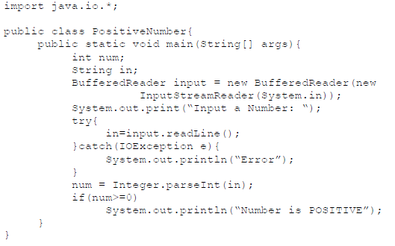
Example: Program that will determine if an input value is positive

Slide 7
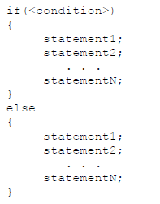
if-else Statement
Syntax:

Slide 8
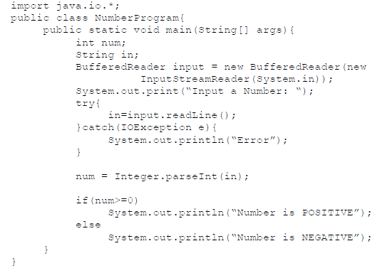
Example: Program that will determine if an input value is positive or negative

Slide 9
Cascading if-else Statement
Syntax:
if (condition){
statements;}
else if (condition){
statements;}
. . .
else{
statements;}

Slide 10
Example: Program that will determine if an input value is positive or negative or neither.
import java.util.*;
public class Number{
public static void main(String[] args){
int no;
Scanner sc=new Scanner(System.in);
no=sc.nextInt();
if(no<0)
System.out.println(“Negative”);
else if(no>0){
System.out.println(“Positive”);
else
System.out.println(“Neither”);
}
}

Slide 11
Nested if Statement
Since if statement is a valid java statement, it can also be used inside another if statement.
Example: Create a program that will compute for an overtime pay of employees based on the given time, day, rate and employee classification. If the employee is regular, the OT pay is equal to the rate per hour for regular days and 50% additional for weekends. For contractual employees, OT is 50% regardless of days work.

Slide 12
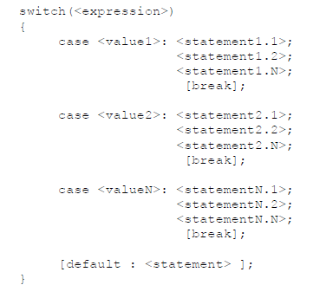
switch Statement
Syntax:

